Slide 1
Movie Genre Classifier

Slide 2
Original Data
Movies
  Start: 25,308
Genres
  Start: 17
Reviews
  Start: 753,710
Tags
  Used as the data to identify the movie genre

Slide 3
Used Data
Movies
  5,027
    Training Data: 4,045
    Test Data: 1,012
Genres
  4
Tags
  Features: 2178

Slide 4
Models Used
SVM
Decision Tree
Logistic Regression
Neural Network

Slide 5
Tuning
Change Parameters
Use Grid Search To Find Optimal Model

Slide 6
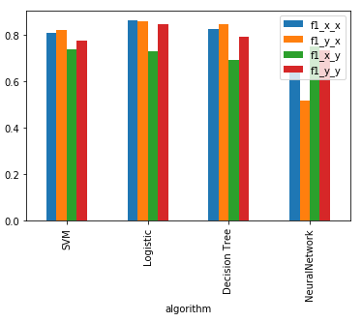
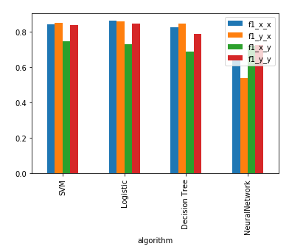
Results
Without Grid Search
With GridSearch

